Slide 1
IP Address
Each computer in a TCP/IP network must be given a unique identifier, or IP address
This address allows one computer to locate another computer on a network
All computers also have a unique physical address, which is known as a MAC address. These are assigned by the manufacturer of the NIC. MAC addresses operate at Layer 2 of the OSI model
Two versions
IPV4
IPV6

Slide 2
IPV4
An IP address (IPv4) is a 32-bit sequence of ones and zeros
To make the IP address easier to work with, it is usually written as four decimal numbers separated by periods
For example, an IP address of one computer is 192.168.1.2. Another computer might have the address 128.10.2.1
This is called the dotted decimal format. Each part of the address is called an octet because it is made up of eight binary digits
For example, the IP address 192.168.1.8 would be 11000000.10101000.00000001.00001000 in binary notation
The dotted decimal notation is an easier method to understand than the binary ones and zeros method
This dotted decimal notation also prevents a large number of transposition errors that would result if only the binary numbers were used

Slide 3
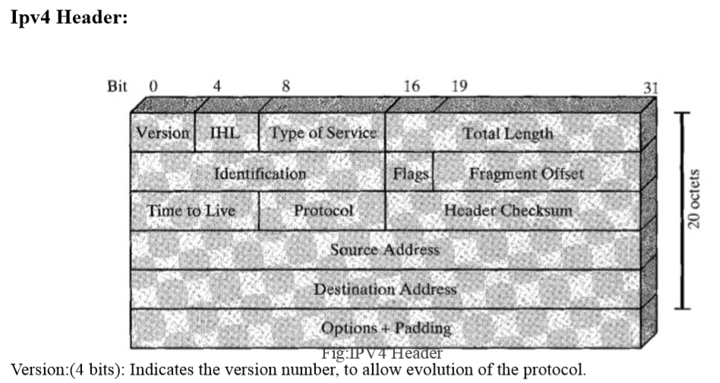
IPV4 Header

Slide 4
IPV4 Header (Contd..)
Internet Header Lenght(IHL 4 bits): Length of header in 32 bit words. The minimum value is five for a minimum header length of 20 octets
Type-of-Service : The Type-of-Service field contains an 8-bit binary value that is used to determine the priority of each packet.
This value enables a Quality-of-Service (QoS) mechanism to be applied to high priority packets, such as those carrying telephony voice data.
The router processing the packets can be configured to decide which packet it is to forward first based on the Type-of-Service value
Total length: total datagram length ,in octets
Identifier (16 bits): A sequence number that, together with the source address, destination address, and user protocol, is intended to uniquely identify a datagram
Thus, the identifier should be unique for the datagram's source address, destination address, and user protocol for the time during which the datagram will remain in the internet
Fragment Offset : A router may have to fragment a packet when forwarding it from one medium to another medium that has a smaller MTU
When fragmentation occurs, the IPv4 packet uses the Fragment Offset field and the MF flag in the IP header to reconstruct the packet when it arrives at the destination host
The fragment offset field identifies the order in which to place the packet fragment in the reconstruction
Flags(3 bits): Only two of the bits are currently defined: MF(More Fragments) and DF(Don't Fragment)

Slide 5
IPV4 Header (Contd..)
More Fragments flag (MF) : The More Fragments (MF) flag is a single bit in the Flag field used with the Fragment Offset for the fragmentation and reconstruction of packets
Don't Fragment flag (DF) : The Don't Fragment (DF) flag is a single bit in the Flag field that indicates that fragmentation of the packet is not allowed
IP Destination Address : The IP Destination Address field contains a 32-bit binary value that represents the packet destination Network layer host address
IP Source Address : The IP Source Address field contains a 32-bit binary value that represents the packet source Network layer host address
Time-to-Live The Time-to-Live (TTL) is an 8-bit binary value that indicates the remaining "life" of the packet
The TTL value is decreased by at least one each time the packet is processed by a router (that is, each hop). When the value becomes zero, the router discards or drops the packet and it is removed from the network data flow
Protocol: This 8-bit binary value indicates the data payload type that the packet is carrying. The Protocol field enables the Network layer to pass the data to the appropriate upper-layer protocol
Example values are: 01 ICMP, 06 TCP, 17 UDP

Slide 6
IPV4 Header (Contd..)
Header checksum (16 bits): An error-detecting code applied to the header only. Because some header fields may change during transit (e.g., time to live, segmentation-related fields), this is reverified and recomputed at each router.
Options (variable). Encodes the options requested by the sending user
Padding (variable). Used to ensure that the datagram header is a multiple of 32 bits
Data (variable). The data field must be an integer multiple of 8 bits. The maximum length of the datagram (data field plus header) is 65,535 octets

Slide 7
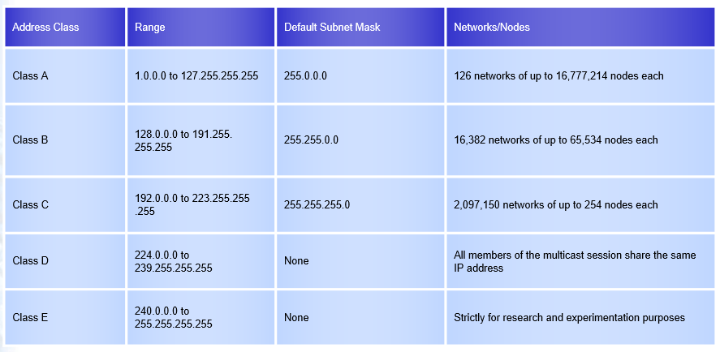
IP Addresses Classes

Slide 8
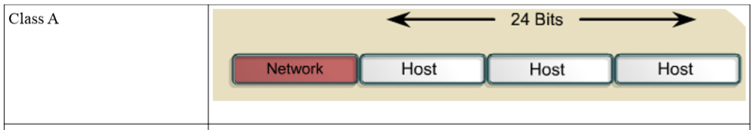
Class A Blocks
A class A address block was designed to support extremely large networks with more than 16 million host addresses
Class A IPv4 addresses used a fixed /8 prefix with the first octet to indicate the network address
The remaining three octets were used for host addresses
The first bit of a Class A address is always 0
With that first bit a 0, the lowest number that can be represented is 00000000, decimal 0
The highest number that can be represented is 01111111, decimal 127
The numbers 0 and 127 are reserved and cannot be used as network addresses
Any address that starts with a value between 1 and 126 in the first octet is a Class A address
No of Class A Network: 2^7
No. of Usable Host address per Network: 2^24-2 (Minus 2 because 2 addresses are reserved for network and broadcast address)

Slide 9
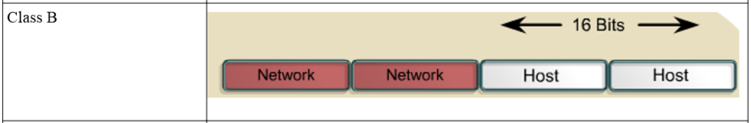
Class B Blocks
Class B address space was designed to support the needs of moderate to large size networks with more than 65,000 hosts
A class B IP address used the two high-order octets to indicate the network address. The other two octets specified host addresses
The first two bits of the first octet of a Class B address are always 10. The remaining six bits may be populated with either 1s or 0s
Therefore, the lowest number that can be represented with a Class B address is 10000000, decimal 128
The highest number that can be represented is 10111111, decimal 191
Any address that starts with a value in the range of 128 to 191 in the first octet is a Class B address
No of Class B Network: 2^14
No. of Usable Host address per Network: 2^16-2

Slide 10
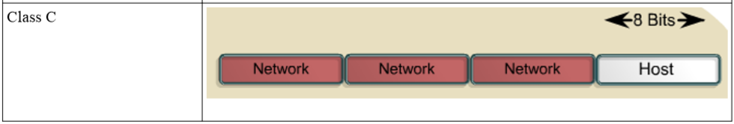
Class C Blocks
The class C address space was the most commonly available of the historic address classes
This address space was intended to provide addresses for small networks with a maximum of 254 hosts
Class C address blocks used a /24 prefix. This meant that a class C network used only the last octet as host addresses with the three high-order octets used to indicate the network address
A Class C address begins with binary 110
Therefore, the lowest number that can be represented is 11000000, decimal 192. The highest number that can be represented is 11011111, decimal 223.
If an address contains a number in the range of 192 to 223 in the first octet, it is a Class C address
No of Class C Network: 221
No. of Usable Host address per Network: 28-2

Slide 11
Class D Blocks
The Class D address class was created to enable multicasting in an IP address
A multicast address is a unique network address that directs packets with that destination address to predefined groups of IP addresses
Therefore, a single station can simultaneously transmit a single stream of data to multiple recipients
The Class D address space, much like the other address spaces, is mathematically constrained. The first four bits of a Class D address must be 1110
Therefore, the first octet range for Class D addresses is 11100000 to 11101111, or 224 to 239. An IP address that starts with a value in the range of 224 to 239 in the first octet is a Class D address

Slide 12
Class E Blocks
A Class E address has been defined
However, the Internet Engineering Task Force (IETF) reserves these addresses for its own research
Therefore, no Class E addresses have been released for use in the Internet
The first four bits of a Class E address are always set to 1s
Therefore, the first octet range for Class E addresses is 11110000 to 11111111, or 240 to 255
Every IP address also has two parts. The first part identifies the network (Network ID)where the system is connected and the second part identifies the system (Host ID)
Within the address range of each IPv4 network, we have three types of addresses:
Network address - The address by which we refer to the network
Broadcast address - A special address used to send data to all hosts in the network
Host addresses - The addresses assigned to the end devices in the network

Slide 13
IPV4 Special Addresses
Default Route: we represent the IPv4 default route as 0.0.0.0. The default route is used as a "catch all" route when a more specific route is not available
Network and Broadcast Addresses: As explained earlier, within each network the first and last addresses cannot be assigned to hosts. These are the network address and the broadcast address, respectively
Loopback: One such reserved address is the IPv4 loopback address 127.0.0.1. The loopback is a special address that hosts use to direct traffic to themselves.
Although only the single 127.0.0.1 address is used, addresses 127.0.0.0 to 127.255.255.255 are reserved. Any address within this block will loop back within the local host. No address within this block should ever appear on any network
Loopback, or loop-back, refers to the routing of electronic signals, digital data streams, or flows of items back to their source without intentional processing or modification. This is primarily a means of testing the transmission or transportation infrastructure
Link-Local Addresses: IPv4 addresses in the address block 169.254.0.0 to 169.254.255.255 (169.254.0.0 /16) are designated as link-local addresses.
These addresses can be automatically assigned to the local host by the operating system in environments where no IP configuration is available. These might be used in a small peer-topeer network or for a host that could not automatically obtain an address from a Dynamic Host Configuration Protocol (DHCP) server.

Slide 14
IPV4 Special Addresses
TEST-NET Addresses : The address block 192.0.2.0 to 192.0.2.255 (192.0.2.0 /24) is set aside for teaching and learning purposes.
These addresses can be used in documentation and network examples
Network Prefixes: An important question is:
How do we know how many bits represent the network portion and how many bits represent the host portion?
When we express an IPv4 network address, we add a prefix length to the network address. The prefix length is the number of bits in the address that gives us the network portion.
For example, in 172.16.4.0 /24, the /24 is the prefix length - it tells us that the first 24 bits are the network address. This leaves the remaining 8 bits, the last octet, as the host portion

Slide 15
Private and Public IP addresses:
Public IP addresses:Public IP addresses are assigned by the InterNIC (Internet's Network Information Centre) and consists of class based network Ids or blocks of CIDR based addresses (called CIDR blocks) that are globally rout-able to the Internet and are unique
For example, when an organization is assigned a CIDR block in the form of a network ID and subnet mask, that [network ID, subnet mask] pair also exists as a route in the routers of the Internet. IP packets destined to an address within the CIDR block are routed to the proper destination
Private IP address:An address that is used for internal networks. These addresses are not rout-able to the Internet
The private address blocks are:
10.0.0.0 to 10.255.255.255 (10.0.0.0 /8)
172.16.0.0 to 172.31.255.255 (172.16.0.0 /12)
192.168.0.0 to 192.168.255.255 (192.168.0.0 /16)

Slide 16
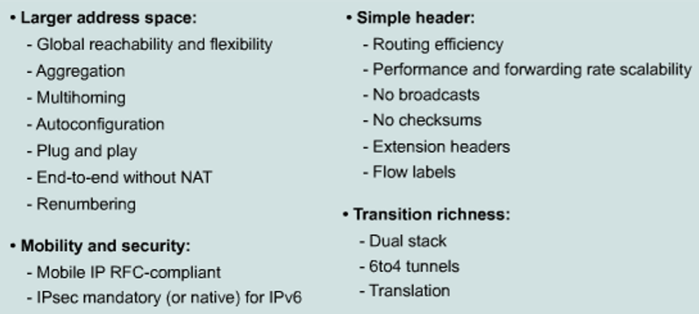
IPV6 Features

Slide 17
IPV6 – Features(Contd.,)
Larger address space : Offers improved global reachability and flexibility;
the aggregation of prefixes that are announced in routing tables;
plug-and-play options;
public-to private readdressing end to end without address translation; and
simplified mechanisms for address renumbering and modification
Simpler header: Provides better routing efficiency;
no broadcasts and thus no potential threat of broadcast storms;
no requirement for processing checksums;
simpler and more efficient extension header mechanisms;
Mobility and security: Ensures compliance with mobile IP and IPsec standards functionality;
mobility is built in, so any IPv6 node can use it when necessary;
and enables people to move around in networks with mobile network devices—with many having wireless connectivity

Slide 18
IPV6 – Features(Contd.,)
Transition richness: You can incorporate existing IPv4 capabilities in IPv6 in the following ways:
Configure a dual stack with both IPv4 and IPv6 on the interface of a network device
Use the technique IPv6 over IPv4 (also called 6to4 tunneling), which uses an IPv4 tunnel to carry IPv6 traffic

Slide 19
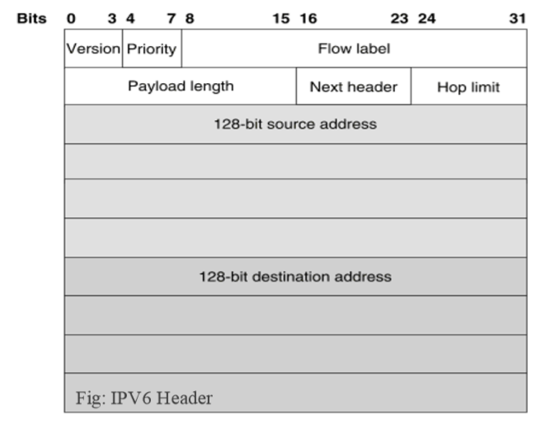
IPV6 - Header

Slide 20
IPV6 - Header
Specifically, IPv6 omits the following fields in its header
header length (the length is constant)
Identification
Flags
fragment offset (this is moved into fragmentation extension headers)
header checksum (the upper-layer protocol or security extension header handles data integrity)
IPv6 options improve over IPv4 by being placed in separate extension headers that are located between the IPv6 header and the transport-layer header in a packet

Slide 21
IPV6 - Addressing
Address Representation:
Represented by breaking 128 bit into Eight 16-bit segments (Each 4 Hex character each)
Each segment is written in Hexadecimal separated by colons
Hex digit are not case sensitive
Rule 1: Drop leading zeros: 2001:0050:0000:0235:0ab4:3456:456b:e560 2001:050:0:235:ab4:3456:456b:e560
Rule2: Successive fields of zeros can be represented as “::” , But double colon appear only once in the address. FF01:0:0:0:0:0:0:1 FF01::1

Slide 22
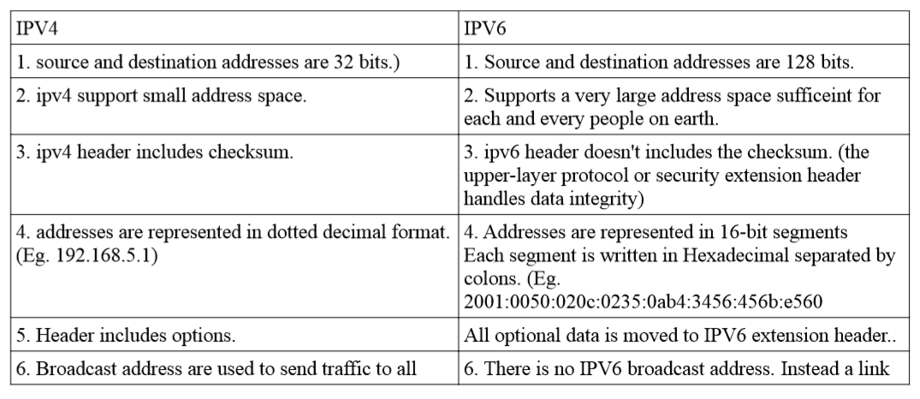
IPV4 vs IPV6

Slide 23
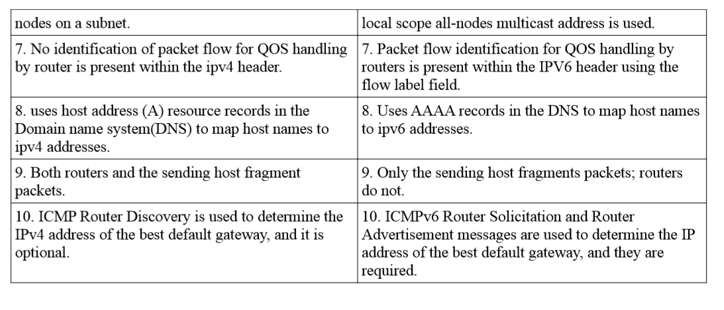
IPV4 vs IPV6

